Slide 1
Chapter 4 Introduction to Control Statements
Fundamentals of Java: AP Computer Science Essentials, 4th Edition
Lambert / Osborne

Slide 2
Objectives
Use the increment and decrement operators.
Use standard math methods.
Use if and if-else statements to make choices.
Use while and for loops to repeat a process.
Construct appropriate conditions for control statements using relational operators.
Detect and correct common errors involving loops.
‹#›
‹#›

Slide 3
Vocabulary
control statements
counter
count-controlled loop
entry-controlled loop
flowchart
infinite loop
iteration
off-by-one error
overloading
random number generator
sentinel
task-controlled loop
‹#›
‹#›

Slide 4
Additional Operators
Extended Assignment Operators:
An assignment operator combined with arithmetic and concatenation operators.
variable op= expression;
variable = variable op expression;
Increment (++) and Decrement(--):
Operators increase or decrease a variable’s value by one.
‹#›
‹#›

Slide 5
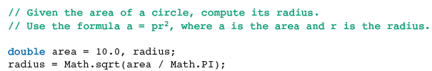
Standard Classes and Methods
The Math Class:
Range of common mathematical methods.
Overloading: having two methods with the same name (abs).
The sqrt method sends a message to the class instead of to an object because the Math class is static.
‹#›
‹#›

Slide 6
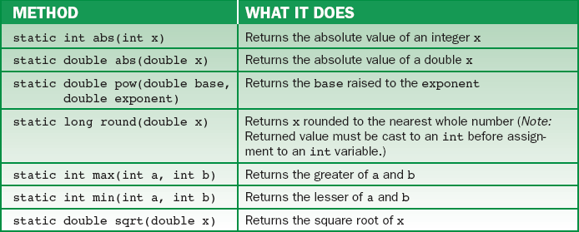
Standard Classes and Methods (continued)
Seven methods in the Math class
‹#›
‹#›

Slide 7
Standard Classes and Methods (continued)
The Random Class:
Supports programs that incorporate random numbers.
Programs are used to simulate random events:
Coin toss, stock market, etc.
Random number generator returns numbers chosen at random from a predesigned interval.
‹#›
‹#›

Slide 8
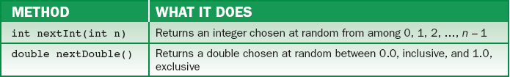
Standard Classes and Methods (continued)
The Random Class (cont):
Programs that use Random class must import java.util.Random.
The output from codes using the Random class is different every time it is generated.
Methods in the Random class
‹#›
‹#›

Slide 9


A Visit to the Farm
if-else and while are control statements.
while means to repeat the action as long as the set condition holds true.
If means to do one thing is the condition is true, and another if the condition is false.
‹#›
‹#›

Slide 10
The if and if-else Statements
Java is programmer-friendly because it combines English phrasing with algebraic notations.
if and if-else are examples.
Required elements:
Semicolons: do not follow a closing brace.
Braces: always in pairs; better to overuse than underuse.
The exact format of the text depends on the programmer.
‹#›
‹#›

Slide 11
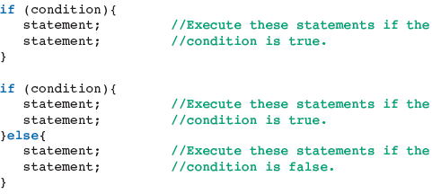
The if and if-else Statements (continued)
Principal Forms:
‹#›
‹#›

Slide 12
The if and if-else Statements (continued)
Additional Forms:
The braces can be dropped if a single statement follows if or else.
The condition in an if statement must be a Boolean expression.
Returns the value true or false.
‹#›
‹#›

Slide 13
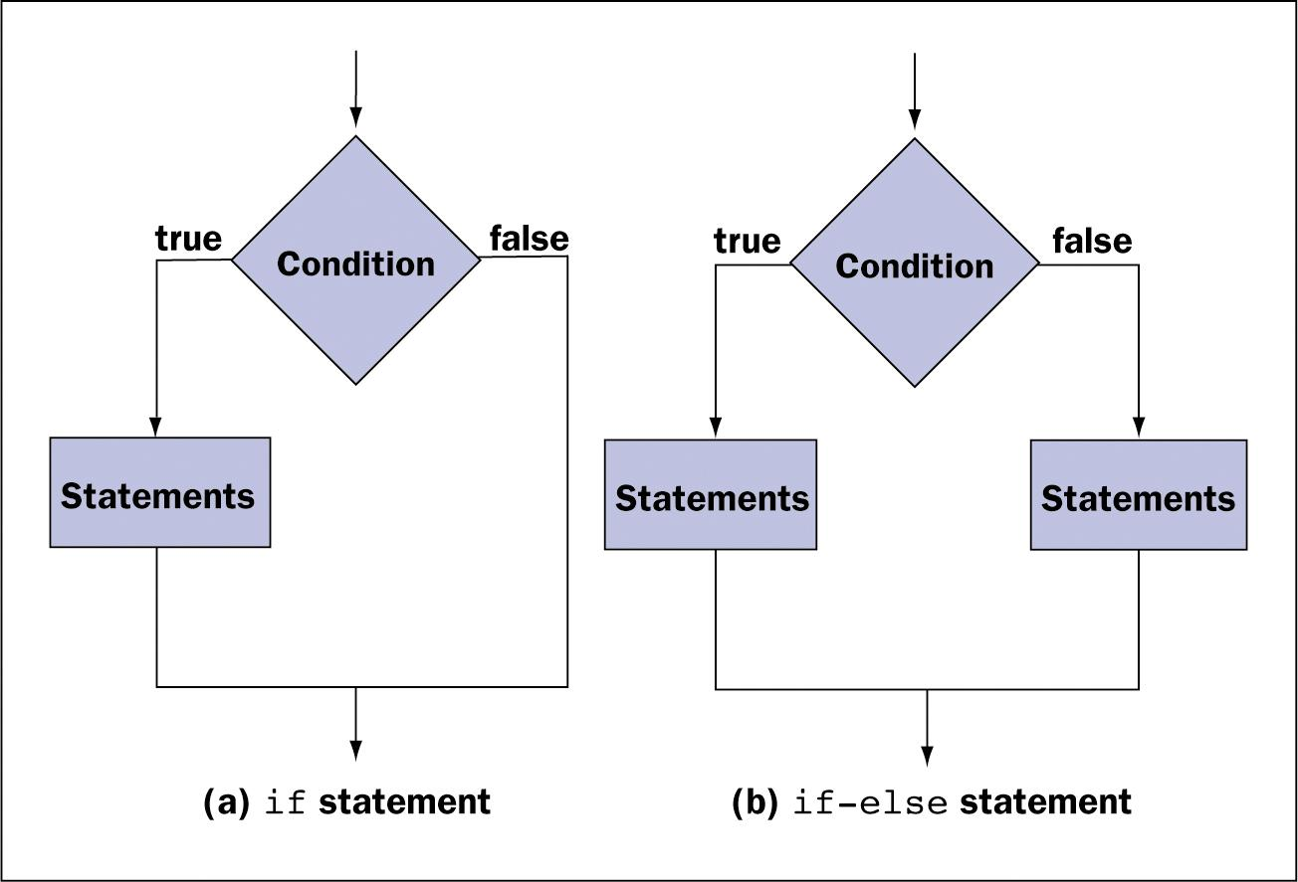
The if and if-else Statements (continued)
Flowcharts for the if and if-else statements.
‹#›
‹#›

Slide 14
The if and if-else Statements (continued)
Relational Operators:
Greater than (>), equal to (==), less than or equal to (<=), not equal to (!=), etc.
== distinguishes the equal-to operator from the assignment operator.
In the not-equal-to operator, ! is read as no.
These values will either be true or false.
‹#›
‹#›

Slide 15
The if and if-else Statements (continued)
Checking Input for Validity:
if-else statements are commonly used to check user inputs before processing them.
For example, if a user enters a negative number for a circle’s radius.
Program checks to see if the radius is >= 0.
If >= 0, the radius is computed.
If < 0, an error message displays.
‹#›
‹#›

Slide 16
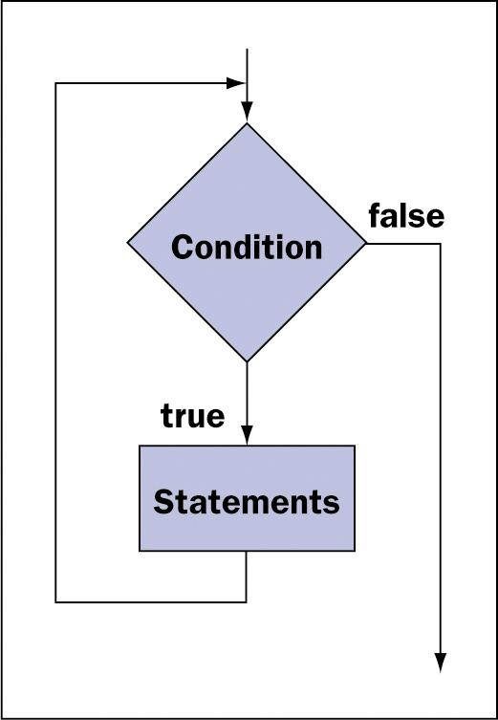
The while Statement
Provides a looping mechanism that executes statements repeatedly as long as some condition remains true.
Flowchart for a while statement
‹#›
‹#›

Slide 17
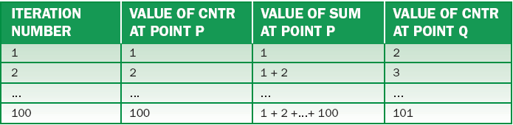
The while Statement (continued)
Count-Controlled Loops:
The variable cntr controls how many times the loop executes.
For example, a program that computes and displays the sum of the integers between 1 and 100.
Each pass of the loop is an iteration.
Trace of how variables change on each iteration through a loop
‹#›
‹#›

Slide 18
The while Statement (continued)
Adding Flexibility:
Could vary the starting value, ending value, and increment, or ask for user input for those values.
Task-controlled loop:
Executes until a task is accomplished.
Example: find the first integer for which the sum 1+2….+n is over 1 million.
The factorial of a given number (n) is the product of the numbers between 1 and n (1*2*3*…*n).
‹#›
‹#›

Slide 19

The while Statement (continued)
Common Structure:
All of these examples share a common structure.
For the loop to terminate, each iteration must move the variables closer to satisfying the condition.
‹#›
‹#›

Slide 20
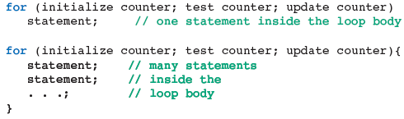
The for Statement
Combines counter initialization, a condition test, and an update in a single expression.
When the statement is executed, the counter is initialized.
As long as the test yields true, the loop continues.
The counter is updated at the bottom of the loop, after the statements in the body have been executed.
‹#›
‹#›

Slide 21
The for Statement (continued)
Count-Controlled Input:
Programs often need to read and process repeating inputs.
Example: computing the average of a list of numbers. List length can vary.
‹#›
‹#›

Slide 22
The for Statement (continued)
Declaring the Loop Control Variable in a for Loop :
The for loop allows the programmer to declare the loop control variable outside of and above the loop header.
Within the loop header is preferable:
Only visible in the body of the loop where it’s being used.
The same name can be declared again in other for loops in the same program.
‹#›
‹#›

Slide 23
The for Statement (continued)
Choosing a while Loop or a for Loop:
Both are entry-controlled loops.
A continuation condition is tested at the top of the loop on each pass to determine if the loop continues (true) or terminates (false).
There are two advantages to choosing a for loop.
All of the loop information (initial setting of loop control variable, its update, and the continuation test) is within the loop header.
The loop control variable of a for loop can be declared in its header.
‹#›
‹#›

Slide 24
Nested Control Statements and the break Statement
Control statements can be nested.
Printing the divisors of a number, excluding 1 and the number.
Determining if a number is prime.
The break statement is used to get out of a loop before the condition is false.
Sentinels are values that mark the end of a list.
Use the do-while and continue statements.
‹#›
‹#›

Slide 25
Using Loops with Text Files
Instead of user input from the keyboard, programs can also read input from a text file.
Software object stored on a permanent medium, such as disk, CD, or flash memory.
Advantages of input data from a file:
Data set can be larger.
Data can be input faster and with less chance of error.
Data can be reused within the same or other programs.
‹#›
‹#›

Slide 26
Using Loops with Text Files (continued)
Text Files and Their Format:
A text file can be created, saved, and viewed with a text editor, such as Notepad.
Characters, words, numbers, or lines of text.
Whitespace characters: space, tab, or newline.
Must be used to separate numbers.
Must include a special character that marks the end of a file.
A sentinel for program loop.
‹#›
‹#›

Slide 27
Using Loops with Text Files (continued)
The Scanner and File Classes:
Scanner class can be used for text file input.
Create a scanner object by opening it in a file object.
File objects are instances of the File class.
new File(aFileName)
aFileName is the pathname or name of the file.
‹#›
‹#›

Slide 28
Using Loops with Text Files (continued)
Files and Exceptions:
Missing or corrupted file.
I/O exception is thrown.
A checked exception: must acknowledge that they might be thrown and do something to recover from them.
Use throws IOException to instruct the JVM to halt execution with an error message.
‹#›
‹#›

Slide 29
Using Loops with Text Files (continued)
Output to Text Files:
Use the class PrintWriter.
Class includes print and println methods.
After outputs are completed, must close the PrintWriter by adding writer.close();
If the output file is not closed, no data will be saved to it.
‹#›
‹#›

Slide 30
Errors in Loops
Logic errors in loops can be avoided by understanding a typical loop structure.
Initializing statements: initialize variables.
Terminating condition: tested before each pass to determine if another iteration is needed.
Body statements: execute with each iteration and implement the calculation in question.
Update statements: change the values of the variables tested in the termination condition.
‹#›
‹#›

Slide 31
Errors in Loops (continued)
Initialization Error:
When you forget to initialize the variable product.
Off-by-One Error:
When a loop goes around one too many or one to few times.
Infinite Loop:
An error in the terminating condition. Detected when a program runs slower than expected. Stop by pressing Ctrl+C.
‹#›
‹#›

Slide 32
Errors in Loops (continued)
Error in Loop Body:
Occurs in body of the loop, such as using the wrong operator.
Update Error:
When an update statement is in the wrong place.
Effects of Limited Floating-Point Precision:
Double numbers have 18 decimal points of precision.
Causes problems for number such as 1/3, which is .3333… and never ends.
‹#›
‹#›

Slide 33
Errors in Loops (continued)
Debugging Loops:
Inspect the code and make sure the following are true.
Variables are initialized before entering the loop.
Terminating condition stops when the variables have reached the limit.
Statements in the body are correct.
Update statements are positioned correctly and modify the variables so that they pass the limits in the terminating condition.
‹#›
‹#›

Slide 34
Errors in Loops (continued)
Debugging Loops (cont):
Use <, <=, >, >= rather than == or !=.
If you cannot find an error by inspection, use System.out.println to dump key variables into the terminal window.
Immediately after the initialization statements.
Inside the loop at the top.
Inside the loop at the bottom.
‹#›
‹#›

Slide 35
Graphics and GUIs: I/O Dialog Boxes and Loops
I/O Dialogs:
A small window that contains:
A message.
A text field for entering input or accepting a default.
Command buttons, such as OK or Cancel.
The class JOptionPane in the package javax.swing includes varieties of showInputDialog for input dialog boxes.
‹#›
‹#›

Slide 36
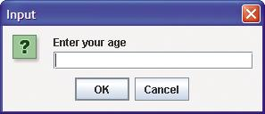
Graphics and GUIs: I/O Dialog Boxes and Loops (continued)
If the user clicks OK, the dialog box closes and returns the string in the text input field.
If the user clicks Cancel, the dialog box closes and returns the value null.
If the value is a number, it must be converted to int or double.
An input dialog
‹#›
‹#›

Slide 37
Graphics and GUIs: I/O Dialog Boxes and Loops (continued)
To output a message, use a message dialog box.
JOptionPane.showMessageDialog(anObserver, aString)
Setting Up Lots of Panels:
Example: a program that sets up a quilt pattern.
User chooses dimensions of the grid (number of rows and columns) and the initial size of the application window.
The program displays them in panels.
‹#›
‹#›

Slide 38
Graphics and GUIs: I/O Dialog Boxes and Loops (continued)
Setting the Preferred Size of a Panel:
The preferred size of a panel can be done in different ways.
The main window class sets its dimensions at program startup.
Give each panel a preferred size and ask the program to shrink-wrap its dimensions to accommodate all of the panels.
‹#›
‹#›

Slide 39
Graphics and GUIs: I/O Dialog Boxes and Loops (continued)
Setting the Preferred Size of a Panel (cont):
Use the setSize method to ask the window to wrap itself around the minimal area necessary to display all of the its components at their preferred size.
If a panel does not set its own preferred size, the default is 0 by 0.
‹#›
‹#›

Slide 40

Graphics and GUIs: I/O Dialog Boxes and Loops (continued)
Drawing Multiple Shapes:
Example: a bulls-eye.
Draw the oval with current color, corner point, and size.
Adjust the corner point by subtracting the thickness from each coordinate.
Adjust the size by subtracting twice the thickness from each dimension.
Adjust the color (white to red or vice versa).
‹#›
‹#›

Slide 41
Design, Testing, and Debugging Hints
Most errors involving selection statements and loops are caught at compile time.
Proper use of braces { } affect the logic of a selection statement or loop.
When testing if or if-else statements, use test data to exercise the logical branches.
Use an if-else statement rather than two if statements if the alternative courses of action are mutually exclusive.
When testing a loop, use limit values and typical values.
‹#›
‹#›

Slide 42
Design, Testing, and Debugging Hints (continued)
Check entry and exit conditions for each loop.
For a loop with errors, use debugging output statements to verify the values of the control variable on each iteration. Check the value before the loop is initially entered, after each update, and after the loop is exited.
Text files are convenient when the data set is large or is used with different programs, and when the data must be permanently saved.
‹#›
‹#›

Slide 43
Summary
In this chapter, you learned:
Java has some useful operators for extended assignment, such as +=, and for increment and decrement.
The Math class provides several useful methods, such as sqrt and abs.
The Random class allows you to generate random integers and floating-point numbers.
‹#›
‹#›

Slide 44
Summary (continued)
if and if-else statements are used to make one-way and two-way decisions.
The comparison operators, such as ==, <=, and >=, return Boolean values that serve as conditions of control statements.
The while loop allows the program to run a set of statements repeatedly until a condition becomes false.
‹#›
‹#›

Slide 45
Summary (continued)
The for loop is a more concise version of the while loop.
Other control statements, such as an if statement, can be nested within loops. A break statement can be used in conjunction with an if statement to terminate a loop early.
There are many kinds of logic errors that can occur in loops. Examples are the off-by-one error and the infinite loop.
‹#›
‹#›

